Slide 1


Airbnb Analytics: Predicting Rental Prices
Prabhu Shankar
Rajivini Tiruveedhula
John P Madhu

Slide 2
Introduction
As the travel industry developed, Airbnb has gained popularity amongst people.
The prices of Airbnb are determined by a number of factors.
It is important to understand these and how they influence pricing strategies.

Slide 3
Business Problem
How can Airbnb hosts and potential renters leverage data to accurately predict rental prices, optimize revenue, and enhance decision-making in a competitive marketplace?
How hosts can use this information to determine pricing?
Determining optimal pricing for their property based on factors like location, amenities, number of people accommodated etc.
Understanding competitive pricing to position their listing attractively .

Slide 4
Data Selection
Our data is very vast, therefore we decided to use the variables that would help us make a meaningful prediction
For this reason, we performed a random forest to decide the most important variables.
A correlation matrix was also used to select variables and understand the relationship.
Variables selected
accommodates
room type
bedrooms
city
amenities count
Instant bookable

Slide 5
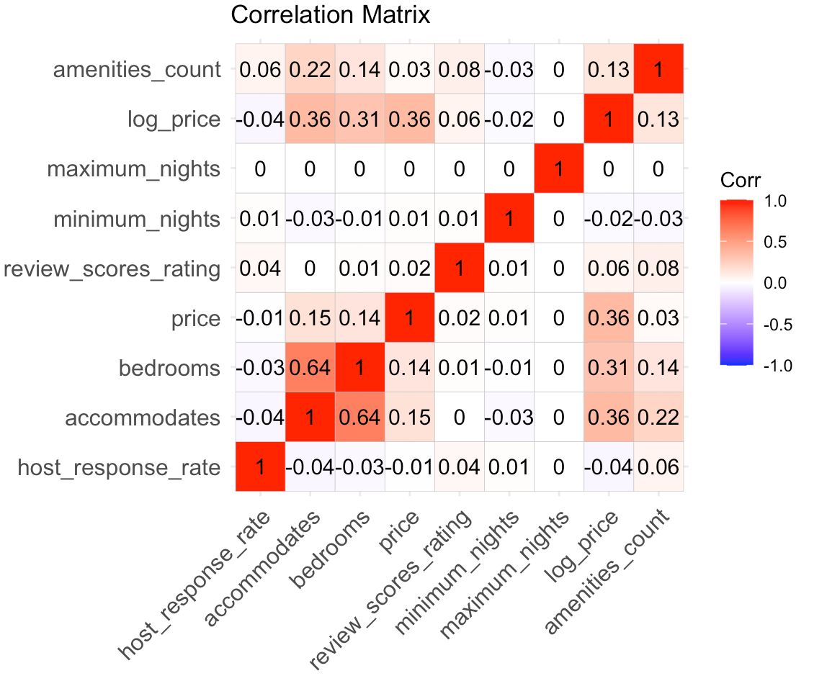
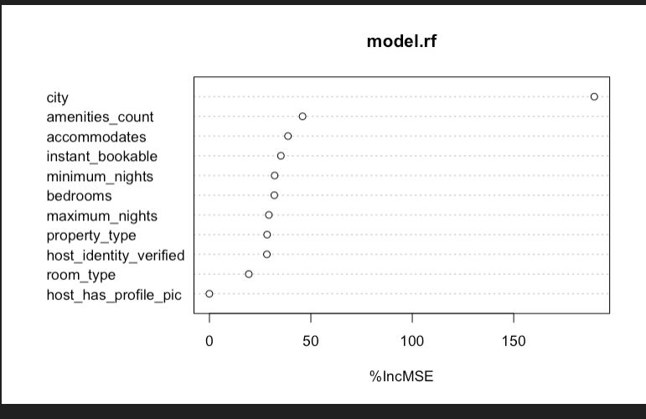
Data Selection

Slide 6
Data Dictionary
VARIABLE | DESCRIPTION
listing_id | listing id specific to each listing on the website
property_type | type of property
room_type | type of room offered
accommodates | number of people each airbnb can accommodate
bedrooms | number of bedrooms for each listing
amenities | different amenities offered
price | price per night
instant_bookable | whether listing can be booked instantly( t of f)
host_has_profile_pic | if host has a profile picture displayed
host_identity_verified | whether host has been verified on the platform
minimum_nights | minimum number of nights a listing needs to be booked
maximum_nights | maximum number of nights a listing can be booked
city | city listing is located in

Slide 7
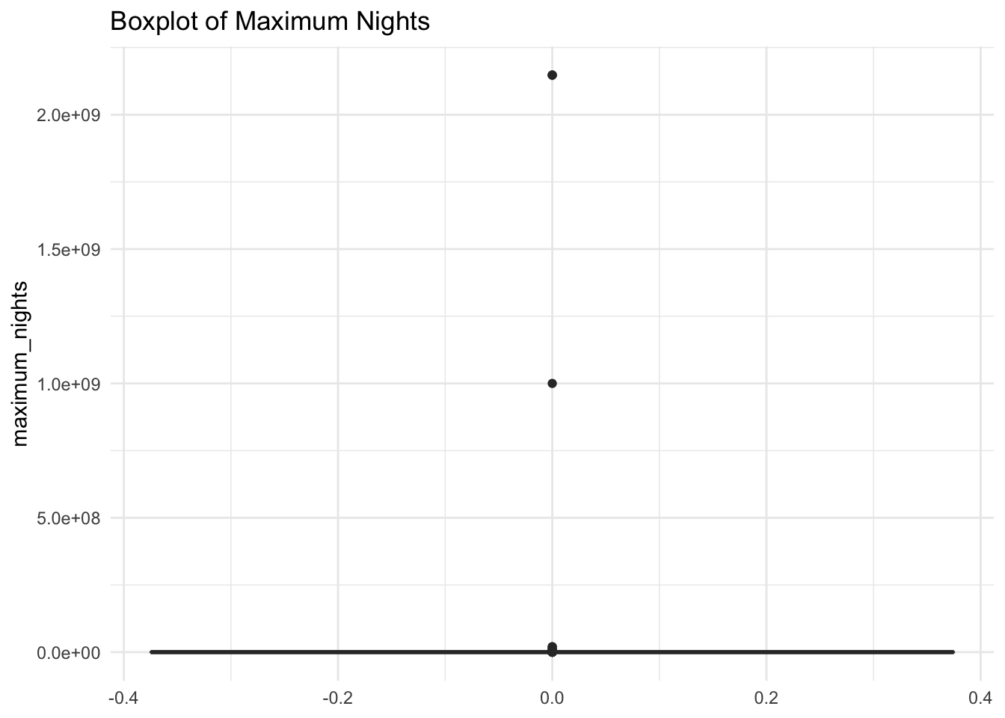
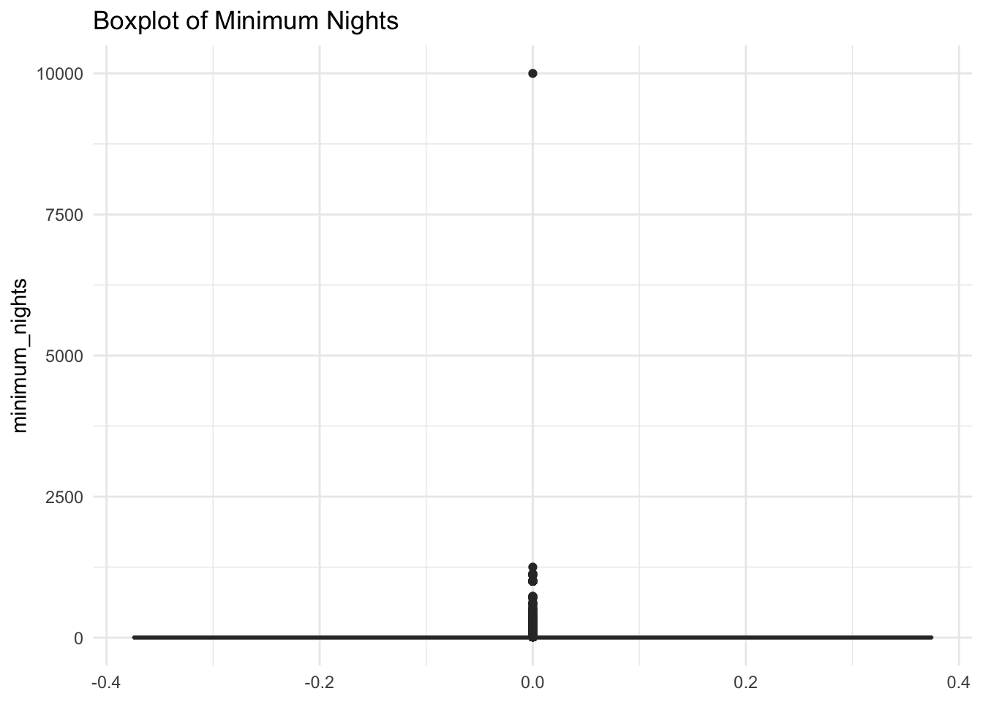
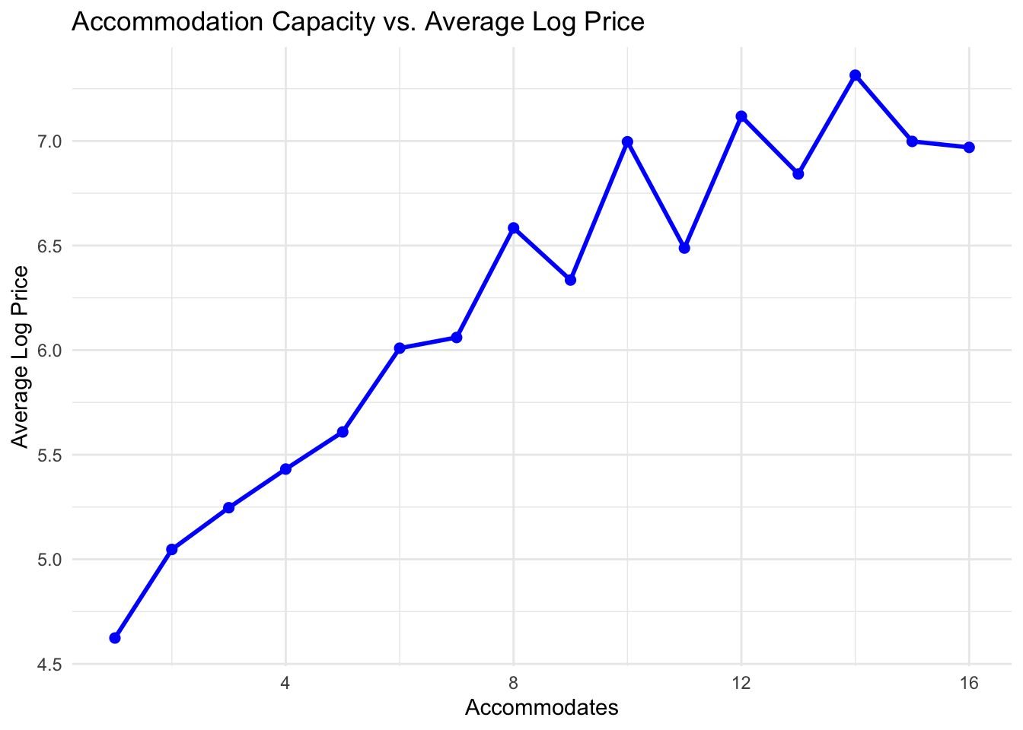
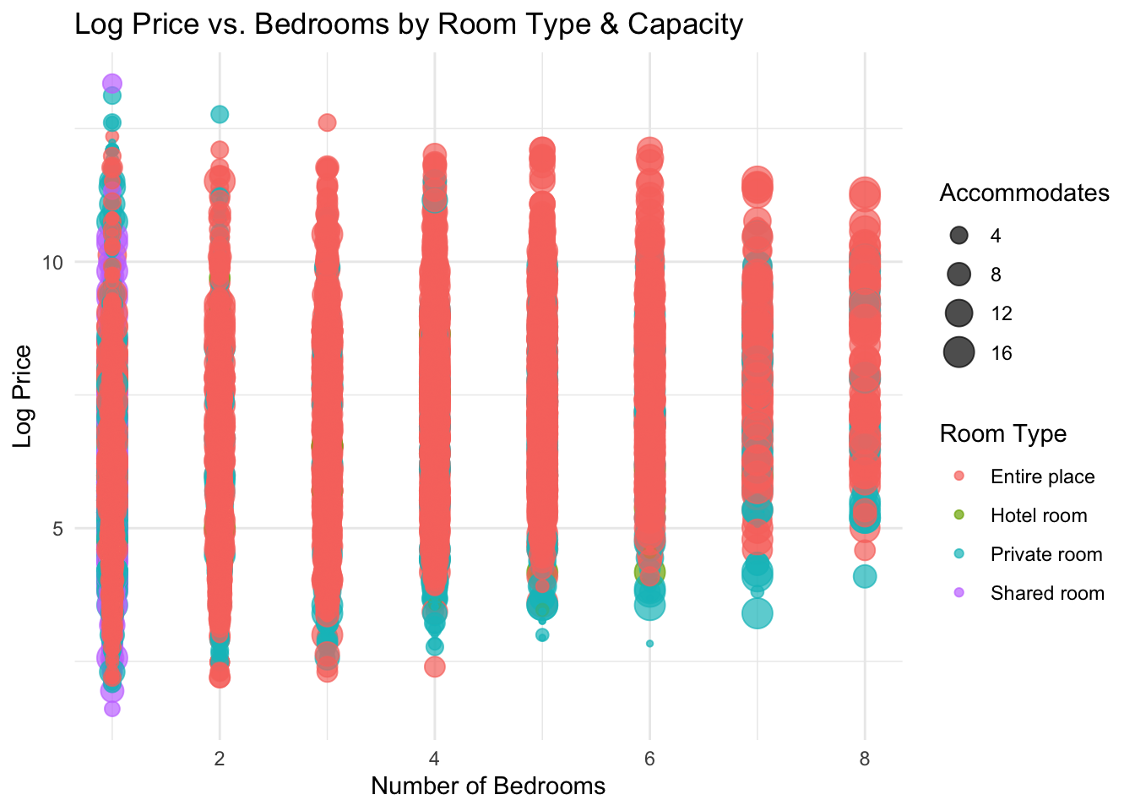
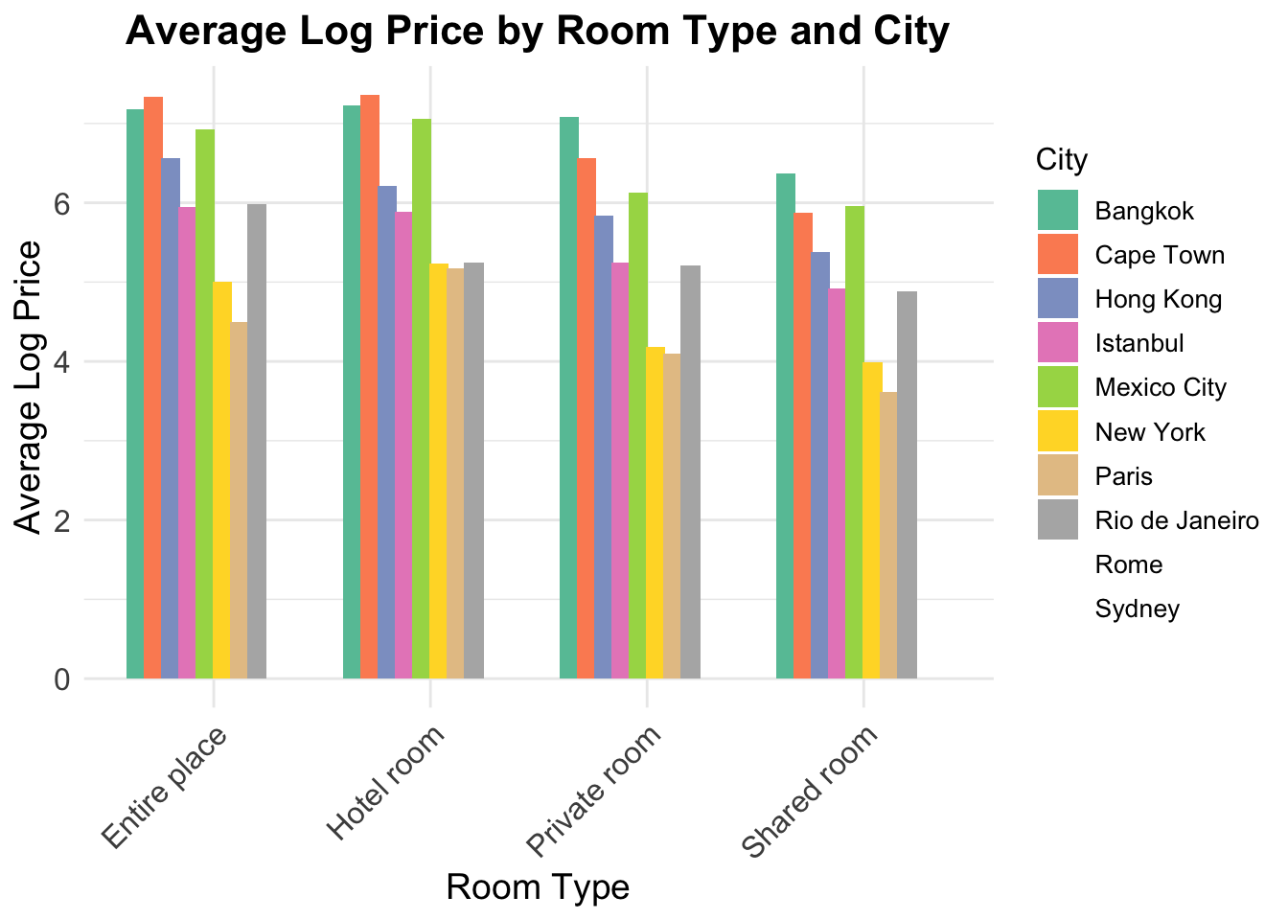
Exploratory Data Analysis

Slide 8
Conclusion on EDA
According to the EDA, significant outliers are found in maximum-nights and minimum-nights.
Listings with extreme values, such as those that permit over 2 billion maximum nights and a minimum stay of 10,000 nights, caused by data entry errors should be fixed.
The average log-transformed price and accommodates show a strong positive correlation, with prices rising gradually up to roughly 12–14 guests, suggesting a decline in profits for large properties.
Model performance and forecast accuracy will be improved by addressing these outliers.

Slide 9
Model 1 Baseline Model
ME | -1.313778e-15
RMSE | 1.22239
MAE | 1.014255
MPE | -5.254462
MAPE | 19.87971
The model shows no significant directional bias, as indicated by the mean error close to zero, but the RMSE of 1.22 and MAE of 1.01 suggest room for improvement in prediction accuracy. While there's a tendency to underpredict by 5.25% (MPE), the overall accuracy is somewhat low with a MAPE of 19.88%, indicating that the model's predictions are, on average, off by nearly one-fifth of the actual values and could benefit from further refinement.

Slide 10
Model 2 Linear Regression
Multiple R-squared | 0.7469
P-value | < 2.2e-16
RMSE | 1.080035
MAE | 0.7625233
No. of Significant variables | 6
The target variable is well explained by the model, and important predictors like the number of bedrooms and facilities offer insightful information. The model's dependability in producing precise forecasts is confirmed by the low error measures (RMSE & MAE).

Slide 11
Model 3 Stepwise Selection
ME | -0.000910085
RMSE | 0.6131524
MAE | 0.4509931
MPE | -1.301084
MAPE | 8.654795
The model's predictions show minimal bias, with a mean error close to zero, indicating no systematic over or underestimation of the target variable. The RMSE and MAE suggest that, on average, predictions deviate from actual values by these amounts in their respective units. While there's a slight tendency to underpredict, the overall accuracy is reasonable, with predictions being off by an average of 8.7%.

Slide 12
Model 4 Random Forest
ME | 0.001257226
RMSE | 0.5986964
MAE | 0.4391814
MPE | -1.381165
MAPE | 8.46435
The model demonstrates minimal bias with a mean error close to zero, indicating no systematic over- or underestimation of the target variable. The RMSE of 0.598 and MAE of 0.439 suggest that, on average, predictions deviate from actual values by these amounts in their respective units. While there's a slight tendency to underpredict (MPE of -1.381%), the overall accuracy is reasonable, with predictions being off by an average of 8.464% (MAPE).

Slide 13
Recommendations
Based on the comprehensive analysis of various models, the decision to use the Random Forest model as the final choice is well-justified. Here's an expanded conclusion:
Superior Performance
Balanced Error Metrics
Minimal Bias
Robustness
Practical Implications
Reliable
Future Directions

Slide 14
Thank You

